Slide 1
Performance of Private Equity Portfolios
Paul A. Strassmann, New Canaan Men Investment Club
May 2, 2016

Slide 2
Introduction to Private Equity Portfolios

Slide 3
Top Hedge Funds Performed Well – April 2016 Status

Slide 4
Top Mutual Funds Have Not Performed Well – April 2016 Status

Slide 5
Observations
Stock Market is +58.7% Over Mean Earnings:
Average investor cannot expect gains
Cheap Debt Encourages Stock Appreciation:
Mutual Funds cannot deliver gains
Private Equity Manages $3.8 Trillion:
Risky, but could be profitable

Slide 6
Increasing Margin Debt Supports Stock Market Growth

Slide 7
The Critical Issue at This Time: Investor Sentiment

Slide 8
S&P Can Grow Only if Both Earnings and Sentiment Improve

Slide 9
Caution: Only Some Hedge Funds are Winners in Past 2 Years
While the S&P 500 index was up 1.2%, the average hedge fund lost 3%. This was on top of several years of sub-par performance.
The S&P 500 has now outperformed average hedge funds for 10 straight years with the exception of 2008, when both fell sharply.
Future growth of S&P 500 and Hedge Funds Risky

Slide 10
Continue Investing in High Return Funds but Track Closely

Slide 11
Private Equity Methods

Slide 12
Private Equity Investors Apply in-Depth Analysis
Fundamental: Industry, market cap, ROA, ROE
Valuation ratios: P/E, PEG, Shiller P/E, EV/EBIT
Profitability: Margins, margin growth
Growth in revenue, EBITDA, EPS, book value
Valuation percentiles across industry
Price, Beta, volume
Dividends: Yield, payout, dividend growth rate
Insiders: CEO/CFO buys

Slide 13
Private Investors Pursue Well-Defined Strategies
Buffett-Munger Screener
Quality stocks young Buffett would buy
Ben Graham Net Current Asset Bargains
Companies Ben Graham would buy
Undervalued Predictable Companies
DCF large margin of safety exists
Historical Low Price to Sales Ratio Companies
Predictable companies that with low P/S ratios
Historical Low Price to Book Value Companies
Cyclically-adjusted price-earnings (CAPE) Method

Slide 14
Superior Performers Can be Ranked – A Few Stand Out
Select Investors that have generated big gains
Superior performance for large portfolios
Value-oriented
Warren Buffett, David Tepper, Bruce Berkowitz,
Low portfolio turnover
Select investors
Global macro: Paul Tudor Jones, Louis Moore Bacon
Quants: Jim Simons, Steven Cohen, etc.

Slide 15
Insider Information Validated
Rank of financial strength, profitability and growth of the company
What other Investors are doing with the stock
What Insiders are doing with it
Review 10-year financial history
Perform Valuations:
Absolute valuation with DCF calculator
Historical valuation history: P/E, P/S, P/B
Relative valuation: how other companies are valued

Slide 16
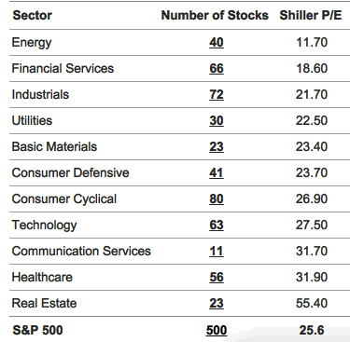
Example of Investment Screen Based on CAPE – March 2016

Slide 17
Sector Selling and Sector Buying Can be Examined (3/12/2016)

Slide 18
Stock Prices Tracked for Timing Purchases

Slide 19
Imitating Private Equity Portfolios

Slide 20
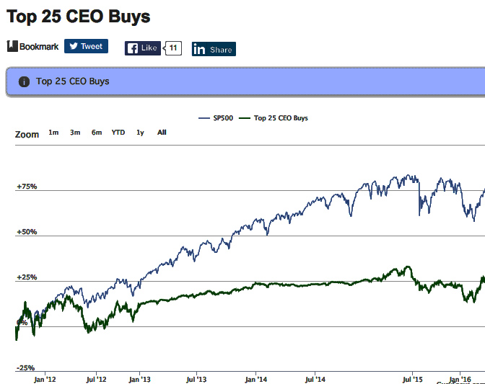
CEO Purchases Not Advantageous
S&P 500
Top CEO Buys

Slide 21
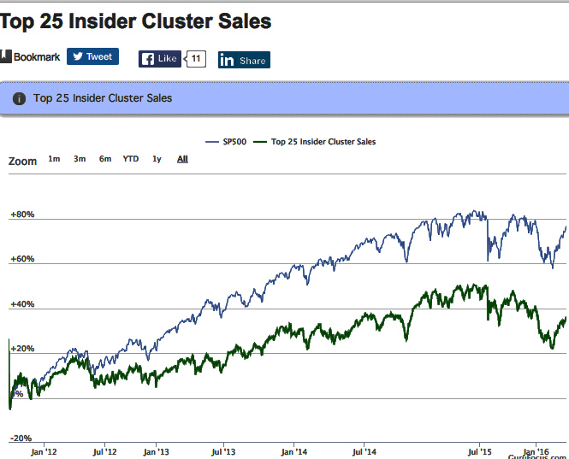
Insider Purchases Not Advantageous
S&P 500
Insider Buys

Slide 22
Observations
Imitating Most CEOs and Insiders Will not Improve Performance.
Tracking S&P 500 Could Deliver Superior Results Immediately.
Performance of Selected Investor Funds Can Be Attractive, but Requires Attention.

Slide 23
Review of Private Equity
Warren Buffett

Slide 24
Purpose of Investment Review
How leading investors can keep the value of their portfolio above long-term sustainable levels.
Investors reviewed:
Warren Buffett - Long term gains: +19.0%/year
David Tepper – Long term gains: +26.7%/year

Slide 25
Performance Based on Selected Criteria
SOURCE: http://www.gurufocus.com/model_portfolio.php?mp=largecap

Slide 26
Examine Cases of a Successful Fund Investment
Humana shares appreciated 174% while S&P increased 66%

Slide 27
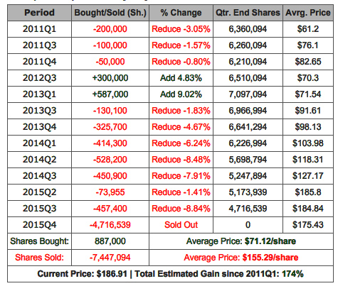
Successful Investment: HUM Shares Sold as 174% Gain

Slide 28
Investment Views of Warren Buffett
•Believes in a margin of safety above all else
•Only buys top-quality businesses at fair prices
•Thinks that no price is cheap enough for a bad company
•Prefers investments that he can hold forever
•Analyzes stocks as if he were buying the entire business
Invest in:
Simple Business
Has Favorable Long-Term Economics
Has Able and Trustworthy Management
Offers a Margin of Safety

Slide 29
Top Buffett Investments

Slide 30
Owner Earnings According to Warren Buffett
Net Income
+ Depreciation, Depletion, Amortization
+ Other Non-Cash Items
+ Average Maintenance Capital Expense
---------------------------------------------------------
= Owner Earnings

Slide 31
Buffett-Munger Investment Results

Slide 32
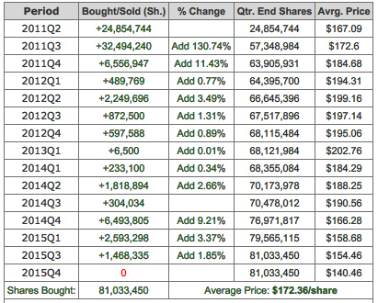
Warren Buffett Holds 81 Million Shares – 8.43% of IBM

Slide 33
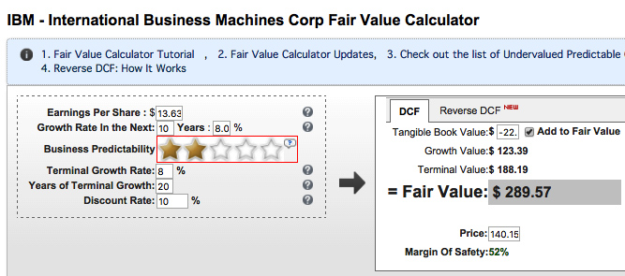
IBM Share Price: Current Value = $140.15; Fair Value = $289.57
SOURCE: http://www.gurufocus.com/dcf/IBM - 03/08/2016

Slide 34
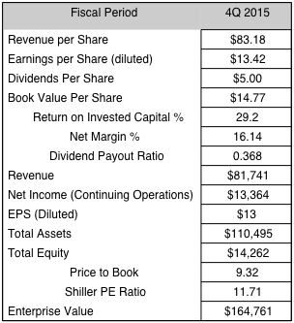
180 Indicators Are Favorable – 1996-2015

Slide 35
Warren Buffett’s Investment in IBM
Potential future +10 year profit >$1 Billion.
Shares can be immediately sold for small gain.
Current dividends exceed the cost of capital.
SUMMARY:
IBM purchase an example of a hedge fund bet.

Slide 36
Warren Buffett’s Investment in IBM
Potential Profit in +10 years >$1 Billion.
Shares can be immediately sold for small gain.
Current dividends exceed the cost of capital.
SUMMARY:
IBM purchase an example of a private capital bet.

Slide 37
Review of Private Equity
David Tepper

Slide 38
Tepper, the Top Distressed Debt Specialist
Tepper earned a reputation for producing some of the highest quick returns amongst fund managers.
Tepper fund, Appaloosa Investment, produced a 26.7%/annual returns since 1993.
Current portfolio: $ 5 billion.

Slide 39
Tepper follows Ben Graham
Pick companies whose market values are less than two-thirds of net cash value.
During the past 12 months, companies generate positive operating cash flow.
Companies may well go under as economic conditions worsen.
Accept high risk with high gain.

Slide 40
Graham Number for Goodyear Tire & Rubber Company (GT)
Graham Number is a figure that measures a stock's fundamental value by taking into account the company's earnings per share and book value per share.
The Graham number is the upper bound of the price that a defensive investor should pay for the stock.
Graham Number for 2014 = $ 45.87/share

Slide 41
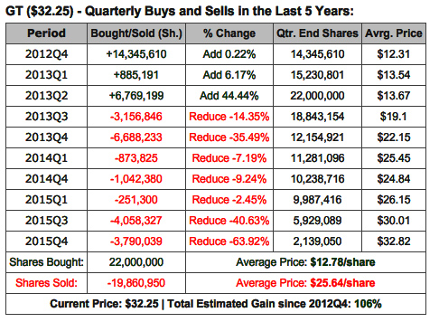
Buy Shares Low Sell Quickly at Multiple of Purchase Price

Slide 42
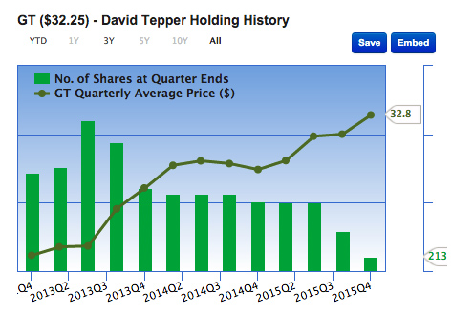
Buy Very Low, Sell for Large Gain

Slide 43
Summary of Private Equity Portfolios

Slide 44
Current Investment Guidelines
Continue Investing in High Return Funds but Track Closely. Risks are High.
Select High Performance private investors or an Insider opportunity. Devote substantial time to detailed analysis. Risks are Very High.
Reduce the volatility of portfolio until stock market reaches more acceptable P/E. Risks are Acceptable.

